Slide 1
Scaling Video Analytics on Constrained Edge Nodes
Christopher Canel, Thomas Kim, Giulio Zhou, Conglong Li, Hyeontaek Lim, David G. Andersen, Michael Kaminsky†, Subramanya R. Dulloor‡
Carnegie Mellon University † Intel Labs ‡ ThoughtSpot
April 1, 2019

Slide 2
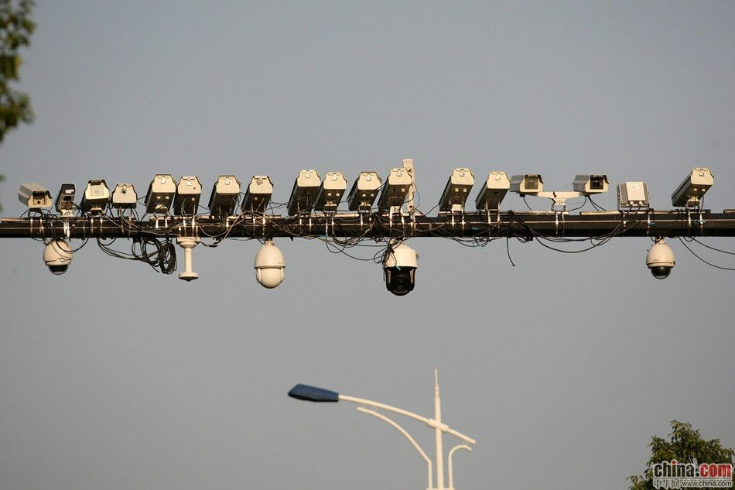
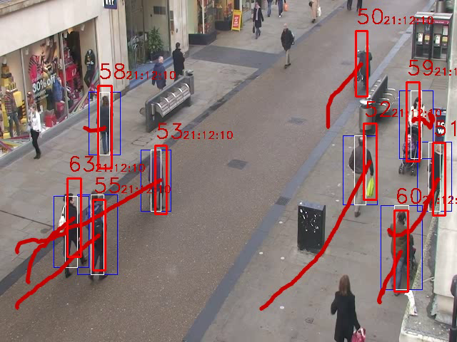

In smart cities, cameras are ubiquitous
More deployments, and importantly, more applications
Cameras in Hangzhou,
Zhejiang Province, China
Traffic monitoring, pedestrian
tracking, event detection, etc.

Slide 3
This talk
Bandwidth challenges in edge-to-cloud camera deployments
Introduce FilterForward, a new system for efficient video filtering on the edge
Discuss microclassifiers, cheap but accurate application-specific NN filters

Slide 4
Bandwidth is limited
low bandwidth
(5 - 40 Mb/s total)
high bandwidth
(many cameras,
> 5 Mb/s each)

Slide 5
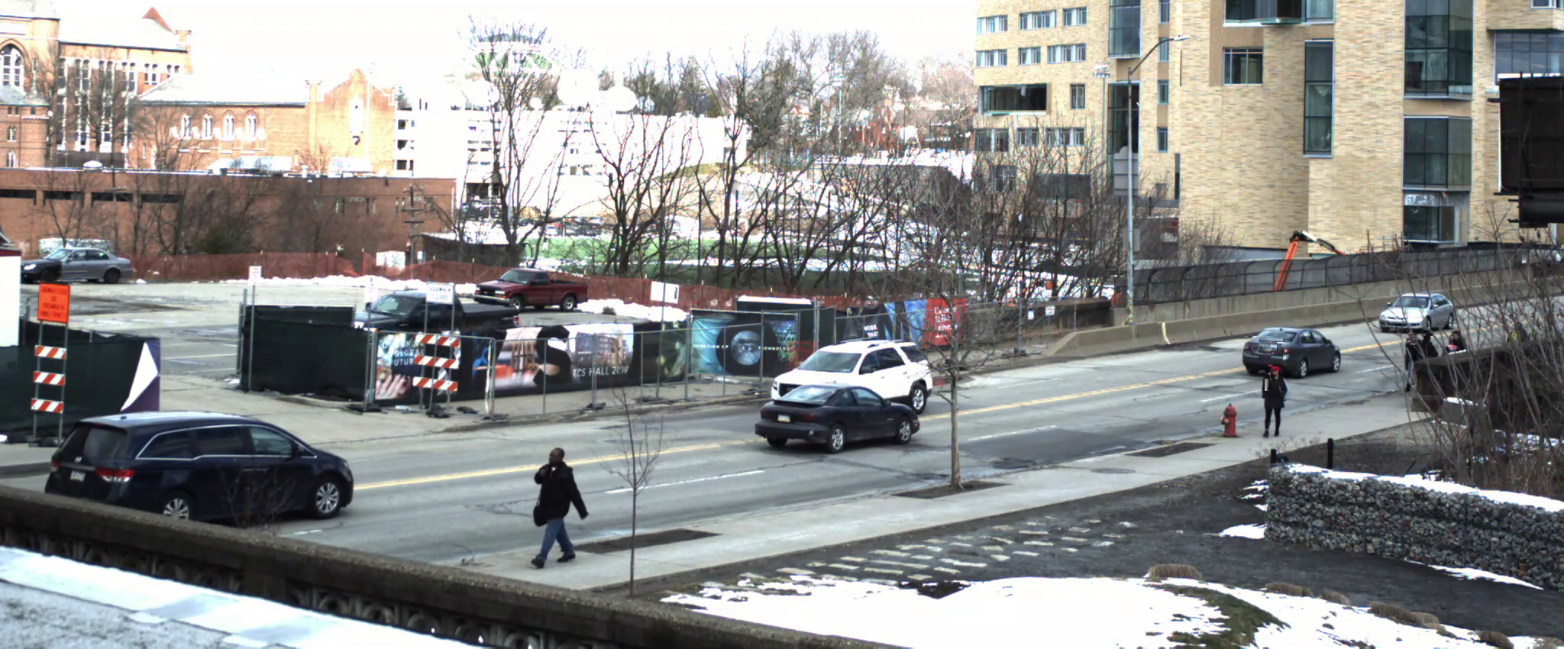
Many apps interested in different content ⇨ Cannot crop to a small ROI

Slide 6


Targeting apps that need subtle details ⇨ Cannot heavily compress the entire stream
Compression and down-sampling destroy subtle details that applications need
Full frame
7000 Kb/s
100 Kb/s

Slide 7
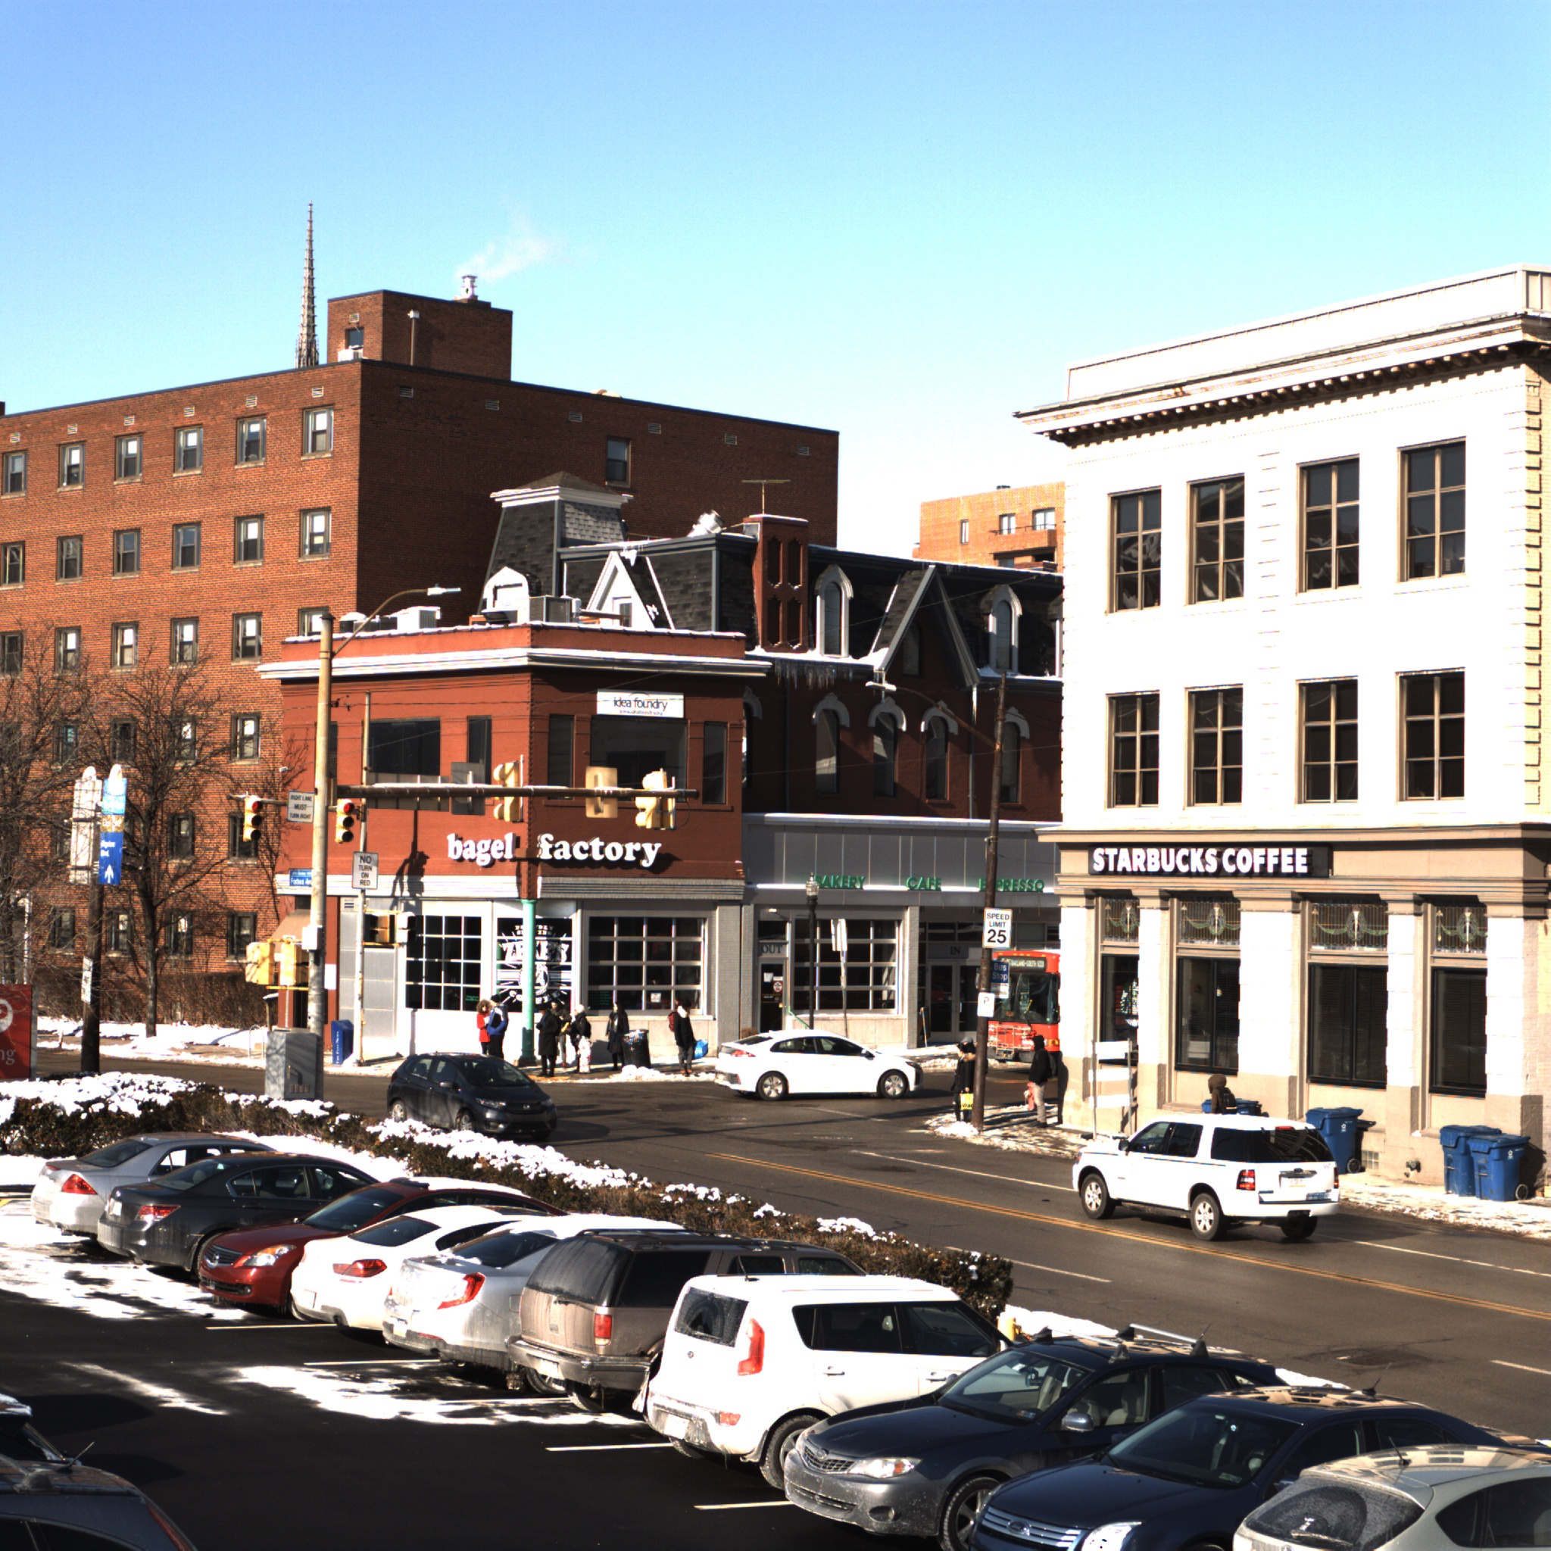
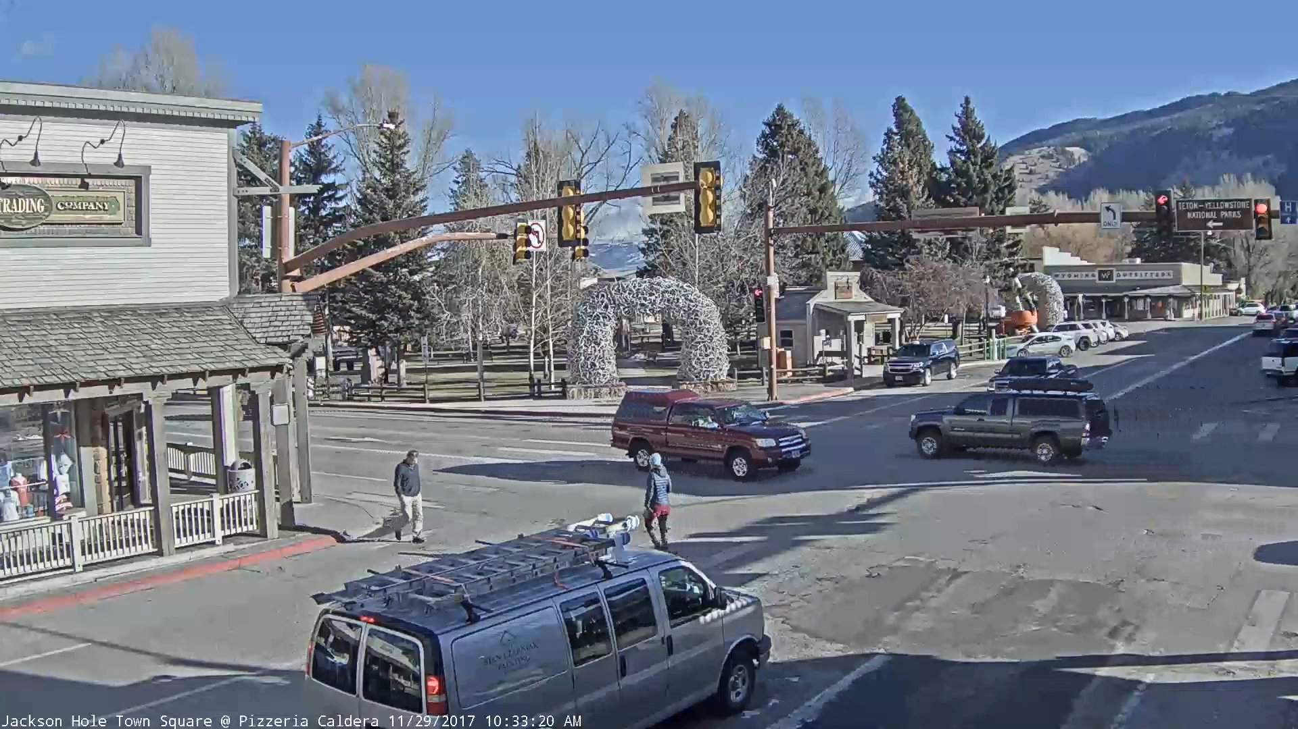
Target environment: Apps interested in rare events
E.g., specific makes/models of vehicles, particular social interactions, etc.
Opportunity to save bandwidth by dropping uninteresting frames
Caveat: Filtering, especially for many apps, requires more compute resources

Slide 8
Our work
FilterForward saves bandwidth by filtering relevant data at the edge, while supporting multi-tenancy

Slide 9
FilterForward at a glance

Slide 10
FilterForward at a glance
User applications run in the datacenter, filtering happens on the edge

Slide 11
FilterForward at a glance
An edge node receives frames from one or more cameras

Slide 12
FilterForward at a glance
FilterForward amortizes pixel processing by using a base DNN to extract features

Slide 13
FilterForward at a glance
FilterForward amortizes pixel processing by using a base DNN to extract features

Slide 14
FilterForward at a glance
FilterForward amortizes pixel processing by using a base DNN to extract features

Slide 15
FilterForward at a glance
FilterForward amortizes pixel processing by using a base DNN to extract features

Slide 16
Microclassifiers are…
Small, individually-trainable neural
nets that determine if a frame is relevant
Scalable: Shared feature extractor amortizes expensive pixel processing
Sensitive to fine-grained details
because they process full-resolution
(e.g., 1920x1080) frames and pull
from any intermediate layer

Slide 17
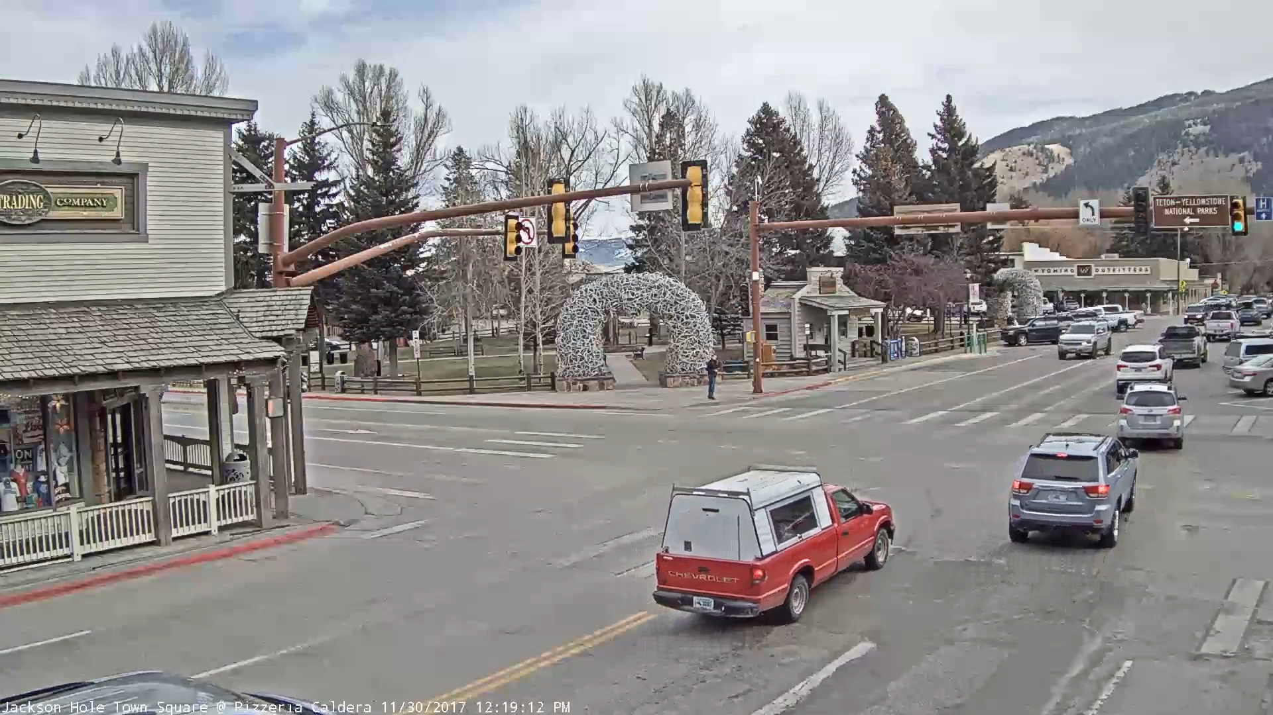
Microclassifier architectures
Full-frame object detector (248M mult.-adds)
Feature
Extractor
1x1
Conv
1x1
Conv
1x1
Conv
Max
Sigmoid
Localized binary classifier (69M mult.-adds)
Feature
Extractor
ConvNet
Sigmoid
Windowed, localized binary classifier (682M mult.-adds)
Feature
Extractor
ConvNet
Sigmoid

Slide 18
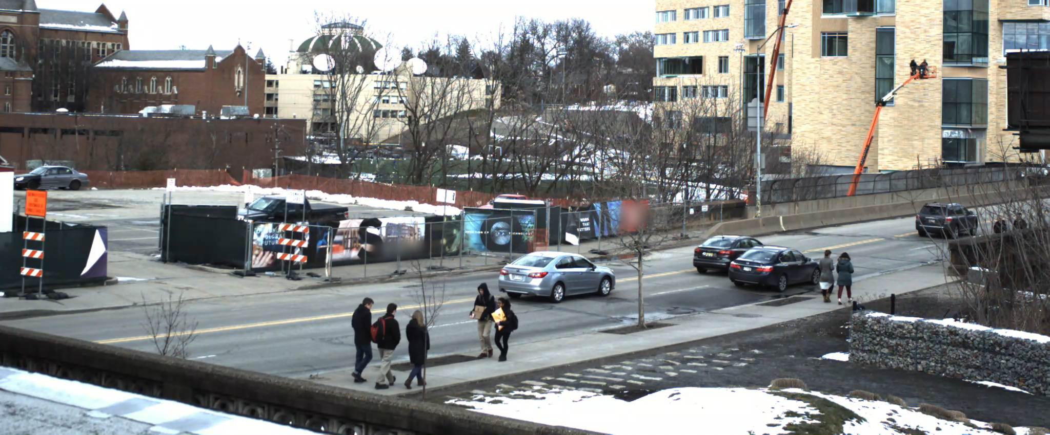
Evaluation datasets
Two real-world camera feeds:
1920x1080
Pedestrians in the crosswalks
2048x850
People wearing red clothes

Slide 19
Evaluation questions
Compare to:
Compress the whole stream using H.264
NoScope-style pixel-based classifiers (discrete classifiers) [Kang et al., 2017]
Bandwidth savings
Throughput scalability
?
?

Slide 20
FF saves bandwidth without sacrificing accuracy
*
6x
*[Lee et al., SysML 2018]

Slide 21
Microclassifiers are accurate yet lightweight
*
11x
*[Lee et al., SysML 2018]

Slide 22
FilterForward scales to many applications
(4-core Intel CPU similar to actual deployments)

Slide 23
FilterForward scales to many applications
(4-core Intel CPU similar to actual deployments)

Slide 24
FilterForward scales to many applications
(4-core Intel CPU similar to actual deployments)

Slide 25
FilterForward scales to many applications
Amortization point:
4 classifiers
4x
(4-core Intel CPU similar to actual deployments)

Slide 26
Summary
FilterForward: A new system for efficient video filtering on the edge
Uses 6x less bandwidth than compression
With 20 classifiers, 4x higher frame throughput than existing techniques
Microclassifiers: Cheap but accurate application-specific NN filters
As accurate as pixel-level classifiers with 11x lower marginal cost
Visit us at the poster session, and online at github.com/viscloud/filterforward
Thank you!

